Slide 1
Create your first Blockchain
Hands-on lab to create your first Blockchain Business Network
Chris Tyler, Darrel Pyle
Technical Evangelists

Slide 2




Chris Tyler
Technical Evangelist
Darrel Pyle
Technical Evangelist
@chrisatyler
@AnalyticsDS
chrisatyler
AnalyticsDS
team-wolfpack
team-wolfpack
#IBMWolfPack

Slide 3
1
What is Blockchain
2
Why should you use Blockchain
3
What Blockchain isn’t
4
5
What is Blockchain for Business
What is IBM Blockchain
6
Hyperledger Composer
7
Hands-on lab
8
Conclusion
Notes:
Today should be an exciting day. We’re going to spend a bit of time first to understand what is Blockchain and why there is so much interest and excitement around it.
Then, we’ll focus briefly on what Blockchain isn’t. This is important, because it fits a certain use case profile and there are some places where Blockchain maybe isn’t a fit.
Next, we’ll focus on Blockchain for Business and what is IBM Blockchain, which is built on Hyperledger Fabric.
Before getting into the lab, we’ll give you a brief overview of Hyperledger Composer, the development tool for building Blockchain applications for Hyperledger Fabric and IBM Blockchain.
Then, we’ll finish up.
Let’s get started.

Slide 4
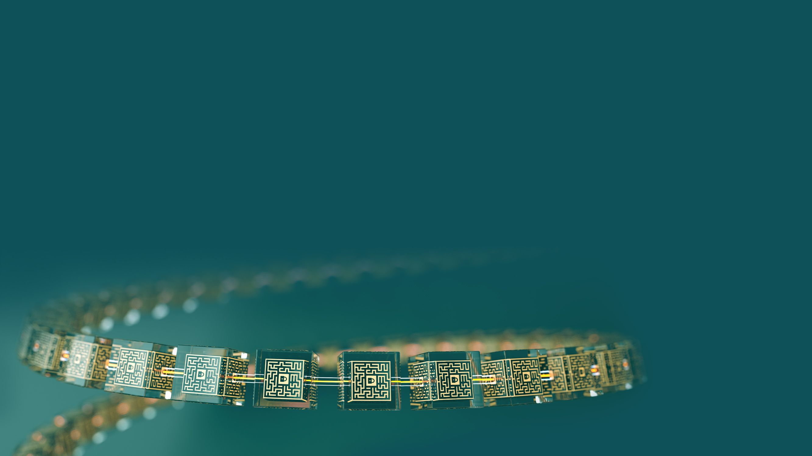
What is Blockchain
An introduction to the Blockchain concepts
Notes:
Blockchain is one of the hottest technology topics going now. For our team, Blockchain, IoT and Machine Learning are probably the top 3 topics asked about.
How many of you have some experience with Blockchain? How many are building applications with Blockchain?
We’re going to do a quick level set of what Blockchain is and what some of the main concepts and components are.

Slide 5
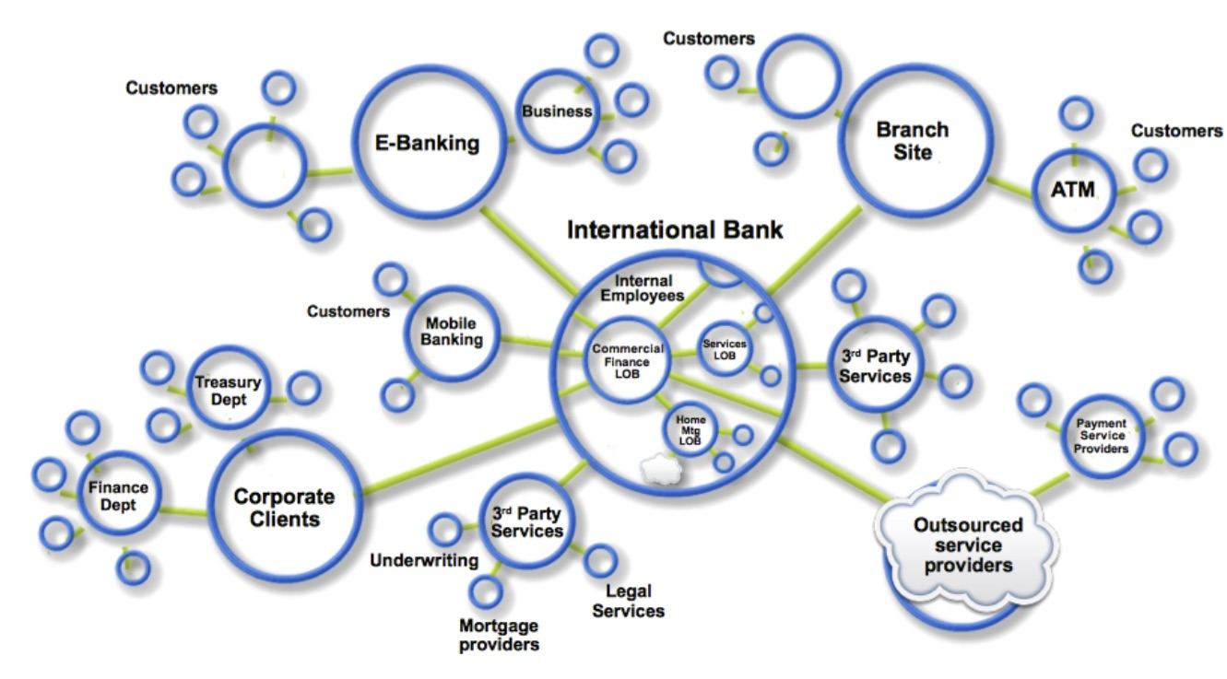
Blockchain Concepts
Business networks are the reasons for blockchains
Business Networks benefit from connectivity
Participants are customers, suppliers, banks, partners
Cross geography and regulatory boundary
Wealth is generated by the flow of goods and services across business network in transactions and contracts
Markets are central to this process:
Public (fruit market, car auction), or
Private (supply chain financing, bonds)
Notes:
First and foremost, Blockchains are built around a Business Network. A Business Network is a group of entities that are working towards a common goal, be that improving supply chain processes and transparency or making electronic trade and commerce cheaper and faster.
These Business Networks benefit from connectivity which makes it faster, easier and cheaper to do business, but there is a need for security as well. Participants in these networks can all play different roles such as customers, suppliers, banks, partners, regulators, etc. They may even cross geographic, political and regulatory boundaries.
Wealth or value is created when goods and services flow through the network. Anything that slows that transfer down, increases costs and decreases profitability. The complexity in contractual terms and conditions and the need for manual intervention are often the causes for this.
Finally, these networks are generally centered around a specific market, which can be a public market or a private market. And these markets are designed to facilitate the trade of goods and services.

Slide 6
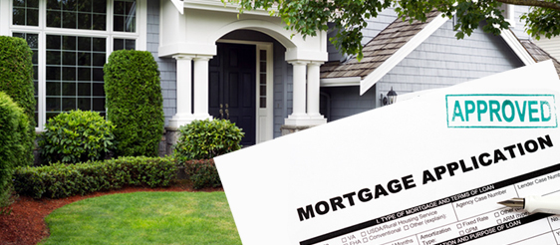

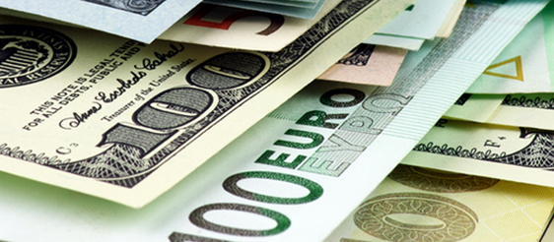
Blockchain Concepts
Assets are meant to be traded
Anything that is capable of being owned or controlled to produce value, is an asset
Two fundamental types of asset | Intangible assets subdivide | Cash is also an asset
Tangible, e.g. a house Intangible, e.g. a mortgage | Financial, e.g. bond Intellectual, e.g. patents Digital, e.g. music | Has property of anonymity
Notes:
These goods and services are assets. Assets can be either tangible or intangible.
Tangible assets are easy to understand. People buy and sell property, cars, products, etc. Intangible assets are a little more challenging to understand, but even when you buy or sell a house, there are other assets involved. There is the financial instrument of the mortgage, there is the title. In the entertainment business, there are digital rights. In the business world, there are patents and contracts. Cash is even an asset.
Most people associate Blockchain with Cryptocurrencies. It’s true that Blockchain is the platform for the tracking and trading of Cryptocurrencies, but it’s only one use for this technology.
And, just like the tracking and tracing of Cryptocurrencies, all transactions need to be tracked and traceable. This is done through a ledger.

Slide 7
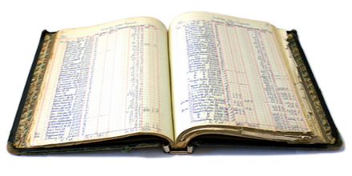
Blockchain Concepts
Ledgers are key to the success of a network
Ledgers are THE system of record for a business.
Businesses will have multiple ledgers for the multiple business networks in which they participate.
Transaction: an asset transfer onto or off the ledger
John gives a car to Anthony (simple)
Contract: the conditions for a transaction to occur
If Anthony pays John money, then car passes from John to Anthony (simple)
If car won't start, funds do not pass to John (as decided by third party arbitrator) (more complex)
Notes:
The ledger is the key to the success of a network or a market. Ledgers are the system of record. It tracks all transactions which involve the transfer of assets between participants. To ensure that the transaction is agreeable between participants, there is generally a contract. The contract spells out the terms and conditions of the trade.
Blockchain keeps a running ledger of every transaction that occurs in a business network. Each participant in the transaction is associated with the transaction and must endorse the transaction and that is all tracked and traceable through the ledger.
So, why use Blockchain? Lot’s of applications today have ledgers built into them. Almost every ERP or Accounting system has a ledger. Let’s explore that next.

Slide 8
Why use Blockchain
What challenges does Blockchain address
Notes:
Why should we use Blockchain? What challenges with existing systems and processes does it address?

Slide 9
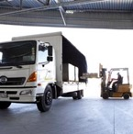


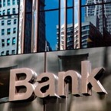



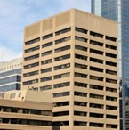
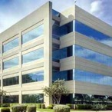



The Problem
Business transactions are inefficient, expensive and vulnerable
Participant B’s records
Participant A’s records
Bank records
Insurer records
Regulator records
Auditor records
Notes:
It’s true today that most applications have a ledger of some sorts that tracks the transactions between entities. The problem is, each participant generally has their own copy, which tells the story from their perspective. There’s no one central place that tells the history of a transaction or an asset as it moves through the process.
This makes transactions inefficient, expensive and vulnerable to fraud or loss.

Slide 10

The Solution
A shared, replicated, permissioned ledger
Participant B’s records
Participant A’s records
Bank records
Blockchain
Insurer records
Regulator records
Auditor records
… with consensus, provenance, immutability and finality
Notes:
Blockchain provides a single view of the transaction history. Each participant can maintain their copy, but all transactions are always applied to every participants copy. The ledger becomes shared across all participants. Security and permissions control what each participant can and can’t see, but they all can have their own copy.
In order for transactions to be applied to the shared ledger, the transaction must pass the terms and condtions set forth by the participants in that transaction and then achieve consensus between the parties that the transaction is valid and should be applied to the ledger. Once applied to the ledger, this transaction cannot be modified or deleted, providing provenance of the assets involved.
So, how is this being applied in business today?

Slide 11
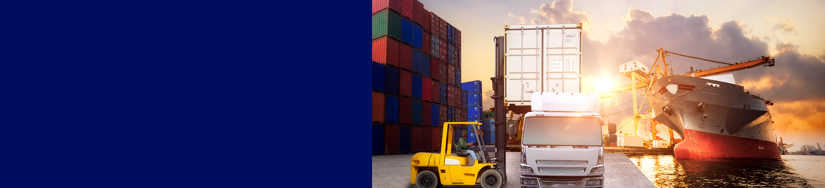
Example
Supply chain
Benefits
Trust increased, no authority "owns” provenance
Improvement in system utilization
Recalls "specific" rather than cross fleet
What | Provenance of each component part in complex system hard to track Manufacturer, production date, batch and even the manufacturing machine program | How | Blockchain holds complete provenance details of each component part Accessible by each manufacturer in the production process, the aircraft owners, maintainers and government regulators
Notes:
In Supply Chain, all product components are tracked and traced through a blockchain until the final product is manufactured and delivered to the end customer. All authorized participants from the manufacture, the product owners, maintenance, and regulators can see the history of the transactions and have trust in the process. If an issue is found later from a specific supplier’s parts, recalls of specific final products can be made because there is a history of where the parts eventually were assembled in the final product.
This is also being used in Food Safety. When there is an issue, such as tainted fruits or vegetables, retailers such as WalMart can find the source of the products in question and know exactly which stores the products are in, pulling only the affected products, not a full removal of all ”similar” products from the shelves.
Additionally, consumers can see that the products were responsibly manufactured and developed and can know from farm to table how the products were cared for.

Slide 12

Example
insurance
Benefits
Creates a new level of trust in the underwriting process
Provides more efficiency with complexities in underwriting
Reduces fraud and errors
What | Records and tracks multi-national payments specific to the terms of the policies Requires consensus among parties associated with the policies | How | Provides a single source for the policy transactions Visibility is controlled by access permissions
Notes:
In the insurance industry, carriers and underwriters are looking for ways to improve the underwriting process, especially multi-national policies. Blockchain provides a single source for all transactions to be tracked and traced, reducing fraud and errors and streamlining the process with smart contracts which eliminate manual processes and paper shuffling.
Similarly, in the real estate industry, Blockchain is being used to reduce the time to close by implementing a single ledger for all participants including home buyers and sellers, realtors, title agents, insurance, mortgage bankers, etc to particpate in a streamlined buying process.

Slide 13
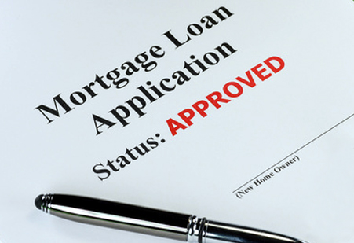
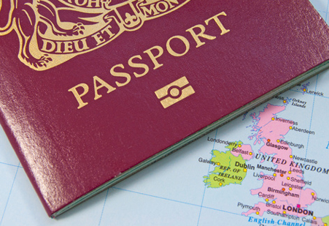


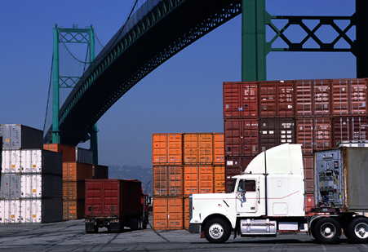
Example
More examples
Financial | Public Sector | Retail | Insurance | Manufacturing
Trade Finance Cross currency payments Mortgages | Asset Registration Citizen Identity Medical records Medicine supply chain | Supply chain Loyalty programs Information sharing (supplier – retailer) | Claims processing Risk provenance Asset usage history Claims file | Supply chain Product parts Maintenance tracking
Notes:
Here are a few other examples. Some patterns will emerge in these.
There are multiple participants
They are all striving for a common goal.
There needs to be trust among all parties.
They are centered around a business process or market.

Slide 14



Key players for Blockchain adoption
You need one to start
Regulator | Industry Group | Market Maker
An organization who enforces the rules of play Regulators are keen to support Blockchain based innovations Concern is systemic risk – new technology, distributed data, security | Often funded by members of a business network Provide technical advice on industry trends Encourages best practice by making recommendations to members | In financial markets, takes buy-side and sell-side to provide liquidity More generally, the organization who innovates - Creates a new good or service, and business process (likely) - Creates a new business process for an existing good or service
Notes:
So, for a Blockchain project to succeed, you need to have at least one of the following:
A Regulator requiring that all participants must play in the network
An Industry Group encouraging the use of the blockchain for the benefit of the group
A Market Maker who will lead the way and create a blockchain for the good of the participants in the market

Slide 15
What Blockchain Isn’t
Some misconceptions and misunderstandings of Blockchain
Notes:
Now, that you understand a little about what Blockchain is, let’s discuss what it isn’t.

Slide 16

What Blockchain Isn’t
Blockchain is not…
Bitcoin
(totally) mature
a product
needed when there is no network
a transaction processing system replacement
a distributed database replacement
a secure messaging replacement
just about cryptocurrency
usually suited for high-volume, low-value transactions
(necessarily) anonymous
Notes:
Since everyone has to have their Top 10 list, like David Letterman (dating myself), here’s the Top 10 things Blockchain isn’t.
Blockchain is not necessarily anonymous. In Cryptocurrencies, this is generally the case, but in the cases presented before around supply chain and insurance, the participants are vetted and are well known.
Blockchain is not usually suited for high-volume, low-value transactions. While McDonald’s may want to use Blockchain to track the supply chain of their hamburgers and french fries, they probably wouldn’t want to track every purchase of a hamburger by the end consumer with a Blockchain.
Blockchain is not just about Cryptocurrency. Yes, Bitcoin is probably the most famous/infamous use of Blockchain and is credited as being among the first incarnations of the technology, there are so many other uses for Blockchain.
Blockchain is not a secure messaging replacement. There is the ability for the notification of participants of events, but it is not the main purpose of the technology and there are many specific applications that are more well-suited for that specific use case.
Blockchain is not a distributed database replacement. Sure, Blockchain is a distributed database, but it is very purpose-built. It is not a general use database. Just like I would not use a NoSQL repository for my Historical Data Warehouse, you wouldn’t want to use Blockchain when something like Hadoop or Db2 is more appropriate.
Blockchain is not a transaction processing system replacement. Again, it has the ability to track transactions, but there is a lot of overhead in the transaction processing in Blockchain, for very good reason, that is generally not needed in a typical Transactional system.
Blockchain is not needed when there is no network. Remember back 2 slides ago. You need some sort of market maker, industry group or regulatory body to drive the use of the Blockchain. And, all participants must be seeking the same goal of transparency and trust. If there’s no network of participants, you don’t need Blockchain.
Blockchain is not a product. Blockchain is a technology platform. There are many flavors of it, some are geared more towards cryptocurrency, some are geared more towards business applications. You build your applications and markets using the Blockchain platform. We’ll cover IBM Blockchain soon, which is a managed service delivering the Blockchain Platform.
Blockchain is not fully mature yet. It is still early on in the Hype Cycle, but has some significant contributors and companies investing in it’s use.
Finally, Blockchain is not Bitcoin. Yes, Bitcoin is an implementation of Blockchain, but Blockchain can be so much more than cryptocurrency.
Let’s talk about Blockchain for Business.

Slide 17
Blockchain for Business
Using Blockchain to build trust
Notes:
Beyond Cryptocurrency, Blockchain is an excellent platform for building business applications. We’ve already talked about a few of these use cases, but let’s examine what it is about Blockchain that makes it a great platform for building business applications.

Slide 18
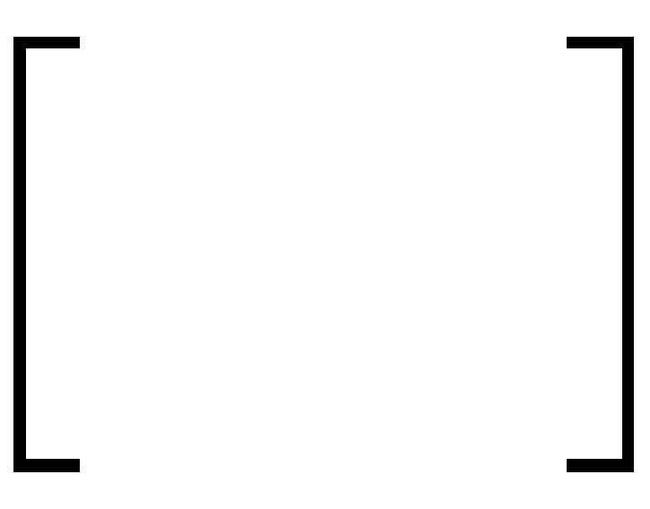

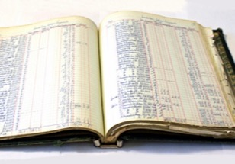
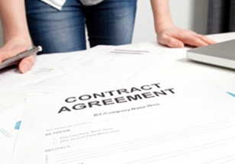




Blockchain for Business
Requires trust
Shared ledger
Smart
contract
Append-only distributed system of record shared across business network
Business terms executed with transactions
Transactions are secure with appropriate visibility
Transactions are provably endorsed by relevant participants
Privacy
Proof
Notes:
Business applications must build trust for success. Blockchain-based solutions require trust, but also build trust.
The shared, immutable ledger, provides that historical view of everything that has occurred. All authorized participants have visibility into this which can help to build trust.
The smart contracts require trust among parties that they can electronically spell out their terms and conditions so that if they grant consensus to a transaction, they are now signifying to all participants that they agreed and consented to that transaction.
With that consent logged to the shared ledger, all authorized participants have proof that the associated participants delivered what they stated they delivered.
I continually mention authorized participants, because security and privacy are critical. If I am trusting that I will be the only one who can submit a specific transaction, or I am the only one who can agree to a specific contract or transaction, no one else should be able to perform those actions. Blockchain uses security to ensure participants are who they say they are and access control is used to limit the capabilities of all participants.
Let’s dig into each of these briefly.

Slide 19
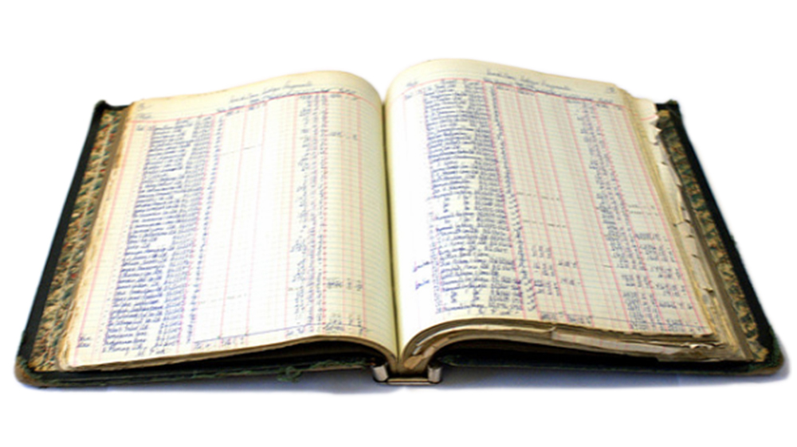
Shared Ledgers
Record of all transactions across the network
Shared between participants
Participants have own copy through replication
Permissioned, so participants see only appropriate transactions
THE shared system of record
Notes:
The ledger records all transactions across the network.
Replication provides a synchronized copy of the ledger to all participants.
Permissions allow participants to only see the transactions they are authorized to see.
This shared ledger becomes that trusted system of record.

Slide 20
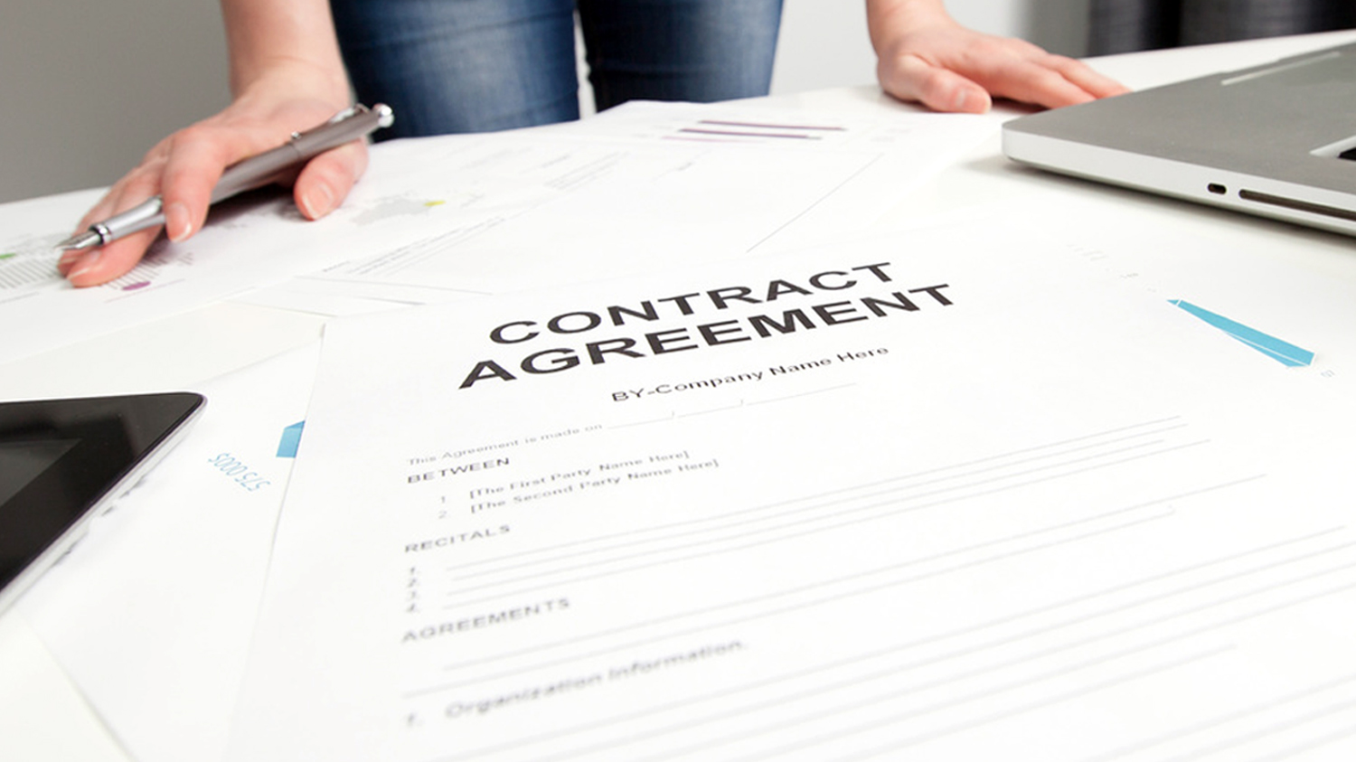
Smart Contracts
Business rules associated with the transaction
Verifiable, signed
Encoded in programming language
Example:
Defines contractual conditions under which a bond transfer occurs
Notes:
Smart contracts is the term given to business rules which are associated with each transaction.
The terms & conditions are dictated by the parties involved in transactions and are verifiable. When a participant endorses a transaction, that participant is signing-off on the transaction, and that endorsement is tracked and traced through the ledger.
As much as the network wants, the smart contracts can be automated through coding language implemented in the Blockchain platform.

Slide 21

Privacy
Participants require privacy and confidentiality
Participants need:
Appropriate privacy and confidentiality between subsets of participants
Identity not linked to a transaction
Transactions need to be authenticated
Cryptography is central to these processes
Notes:
As mentioned above, privacy is critical. Participants in a supply chain may be competitors and should not be able to see transactions the others are involved in.
In order to protect the privacy and confidentiality of the participants and the information in the Blockchain, cryptography is used.

Slide 22

Proof
The ledger is the trusted source of information
Participants endorse transactions
Business network decides who will endorse transactions
Endorsed transactions are added to the ledger with appropriate confidentiality
Assets have a verifiable audit trail
Transactions cannot be modified, inserted or deleted
Achieved through consensus, provenance, immutability and finality
Notes:
Finally, because the ledger is the trusted source of information and participants must agree and endorse the transactions involving multiple participants and assets, there is an inherent audit trail that provides proof to interested parties.
So, what is IBM Blockchain?

Slide 23
IBM Blockchain
What is IBM Blockchain

Slide 24



IBM Blockchain
The ibm blockchain platform
Develop Explore and accelerate development time with tools that ensure close alignment between business leaders and developers
Govern Speed activation, customization and management of your business network with democratic, multi-party governance tooling
Operate Deploy and operate always-on networks with production-ready enterprise performance and security for most demanding use cases
IBM Blockchain Platform is a fully integrated enterprise-ready blockchain platform designed to accelerate the development, governance, and operation of a multi-institution business network
Full lifecycle tooling to speed activation and management of your network
Specialized compute for security, performance and resilience
Delivered via the IBM Cloud on a global footprint with 24x7 Integrated Support
Based on Hyperledger Fabric V1 runtime and using Hyperledger Composer development tools
http://ibm.biz/Platform_Demo
Notes:
The IBM Blockchain Platform is a managed service, built with Hyperledger Fabric. IBM delivers this through the IBM Cloud and provides 24x7 support. Additional tooling for simplifying the management of the business network and for monitoring the network are included.
Hyperledger Composer is the development tool for building your business network.

Slide 25


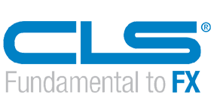
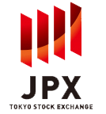

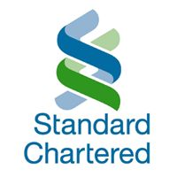

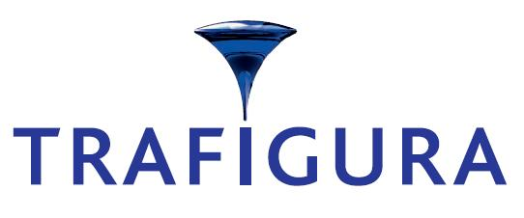




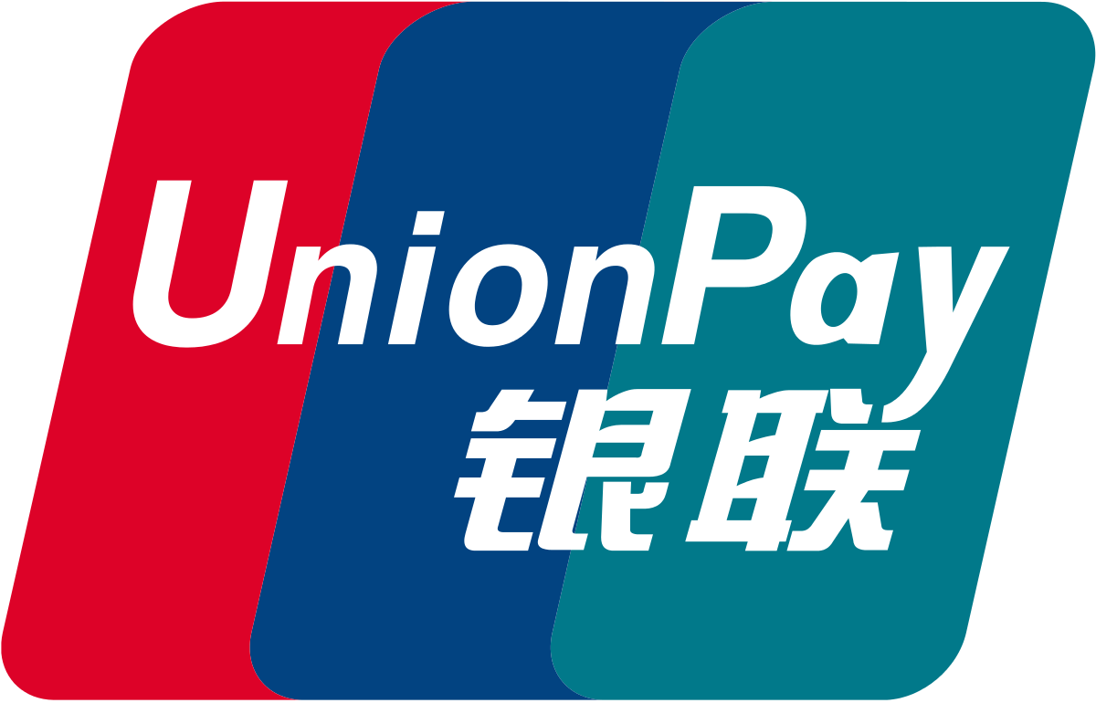
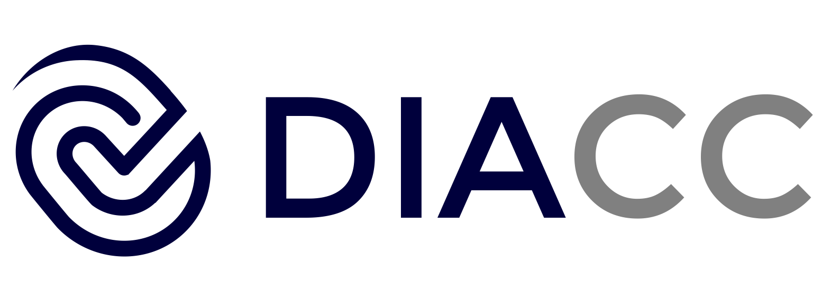


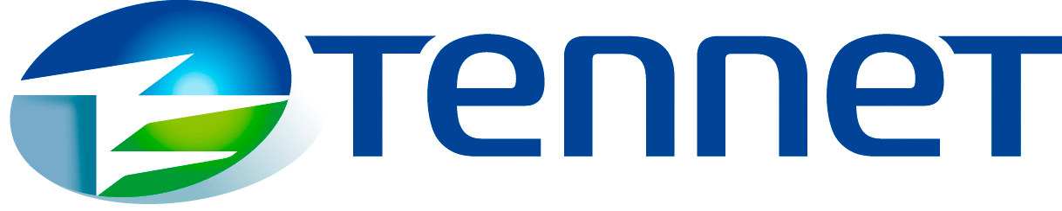
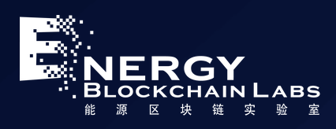
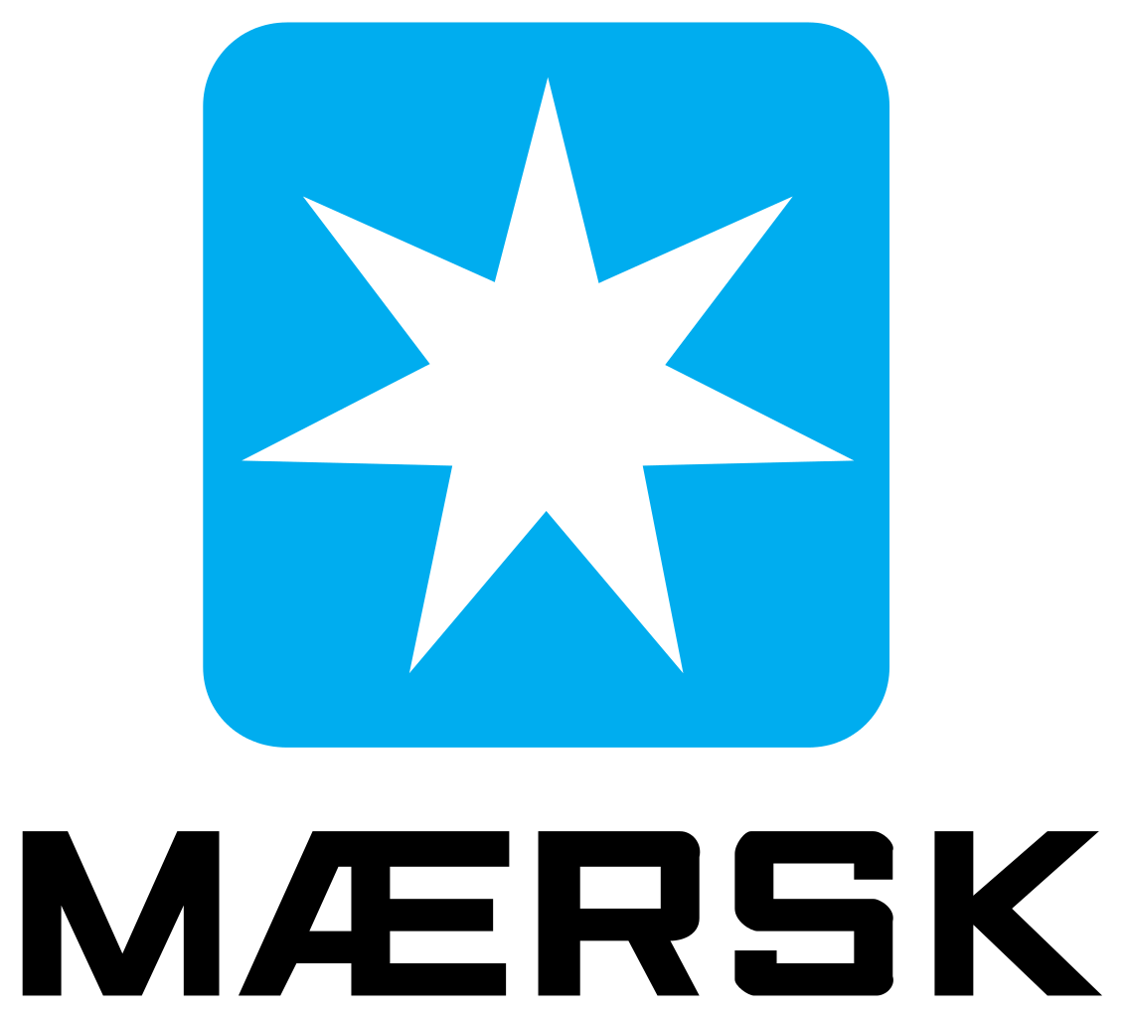

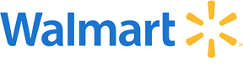
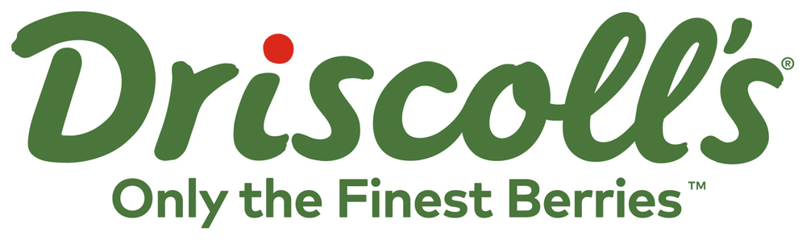
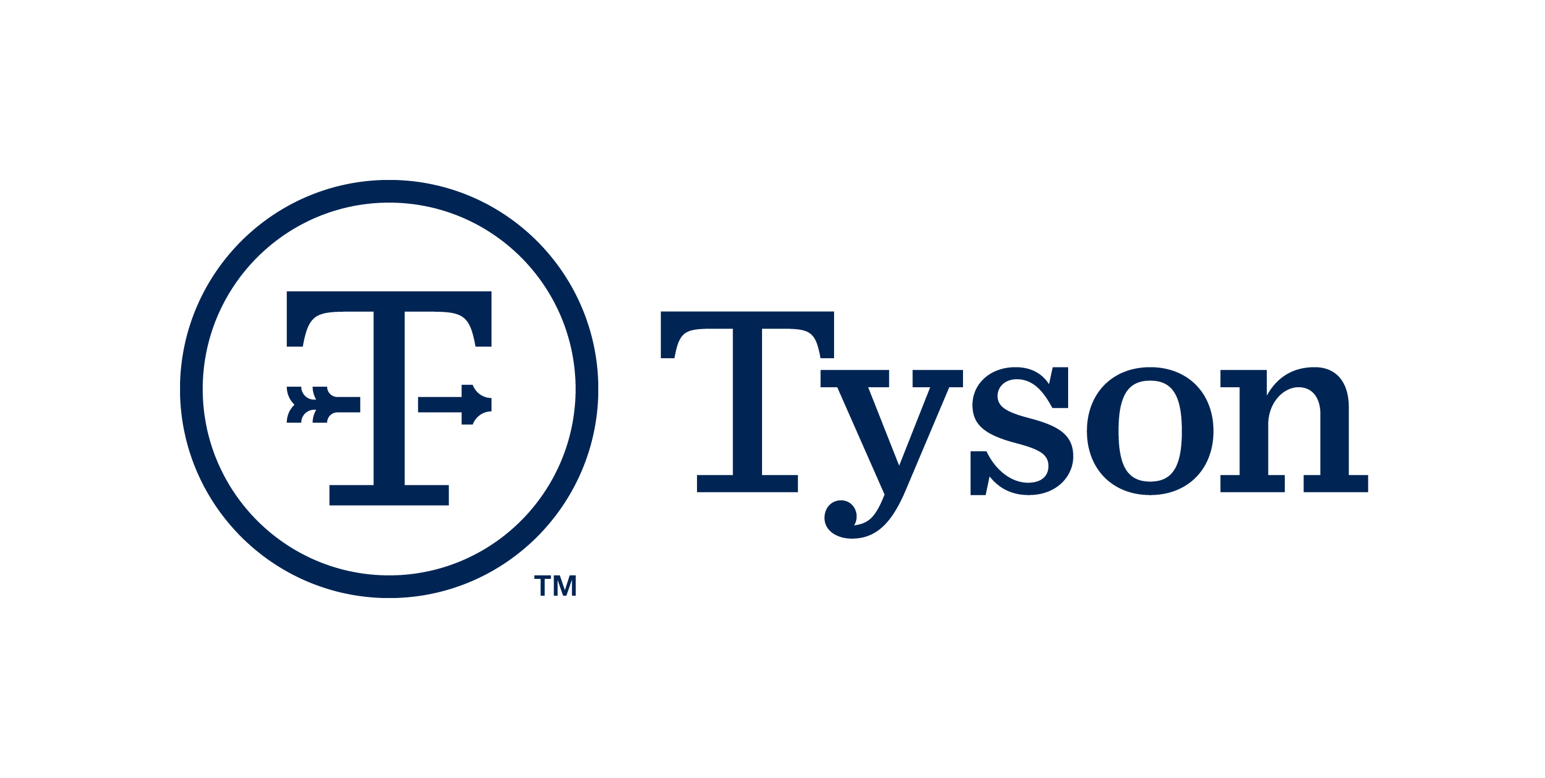
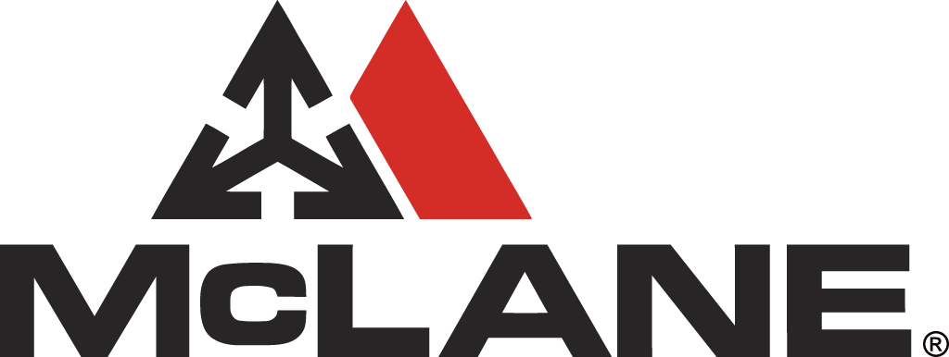


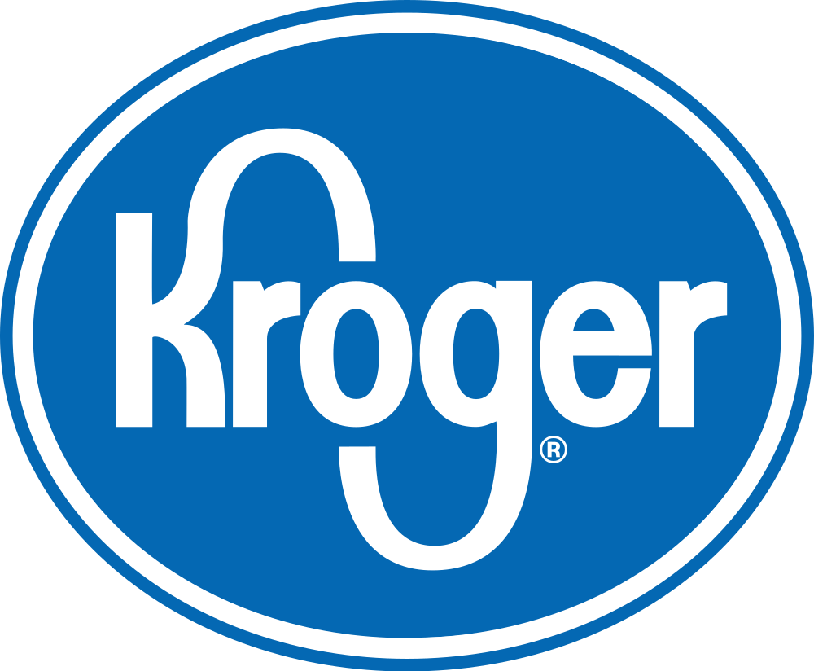
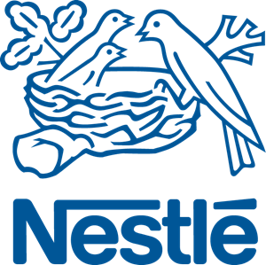


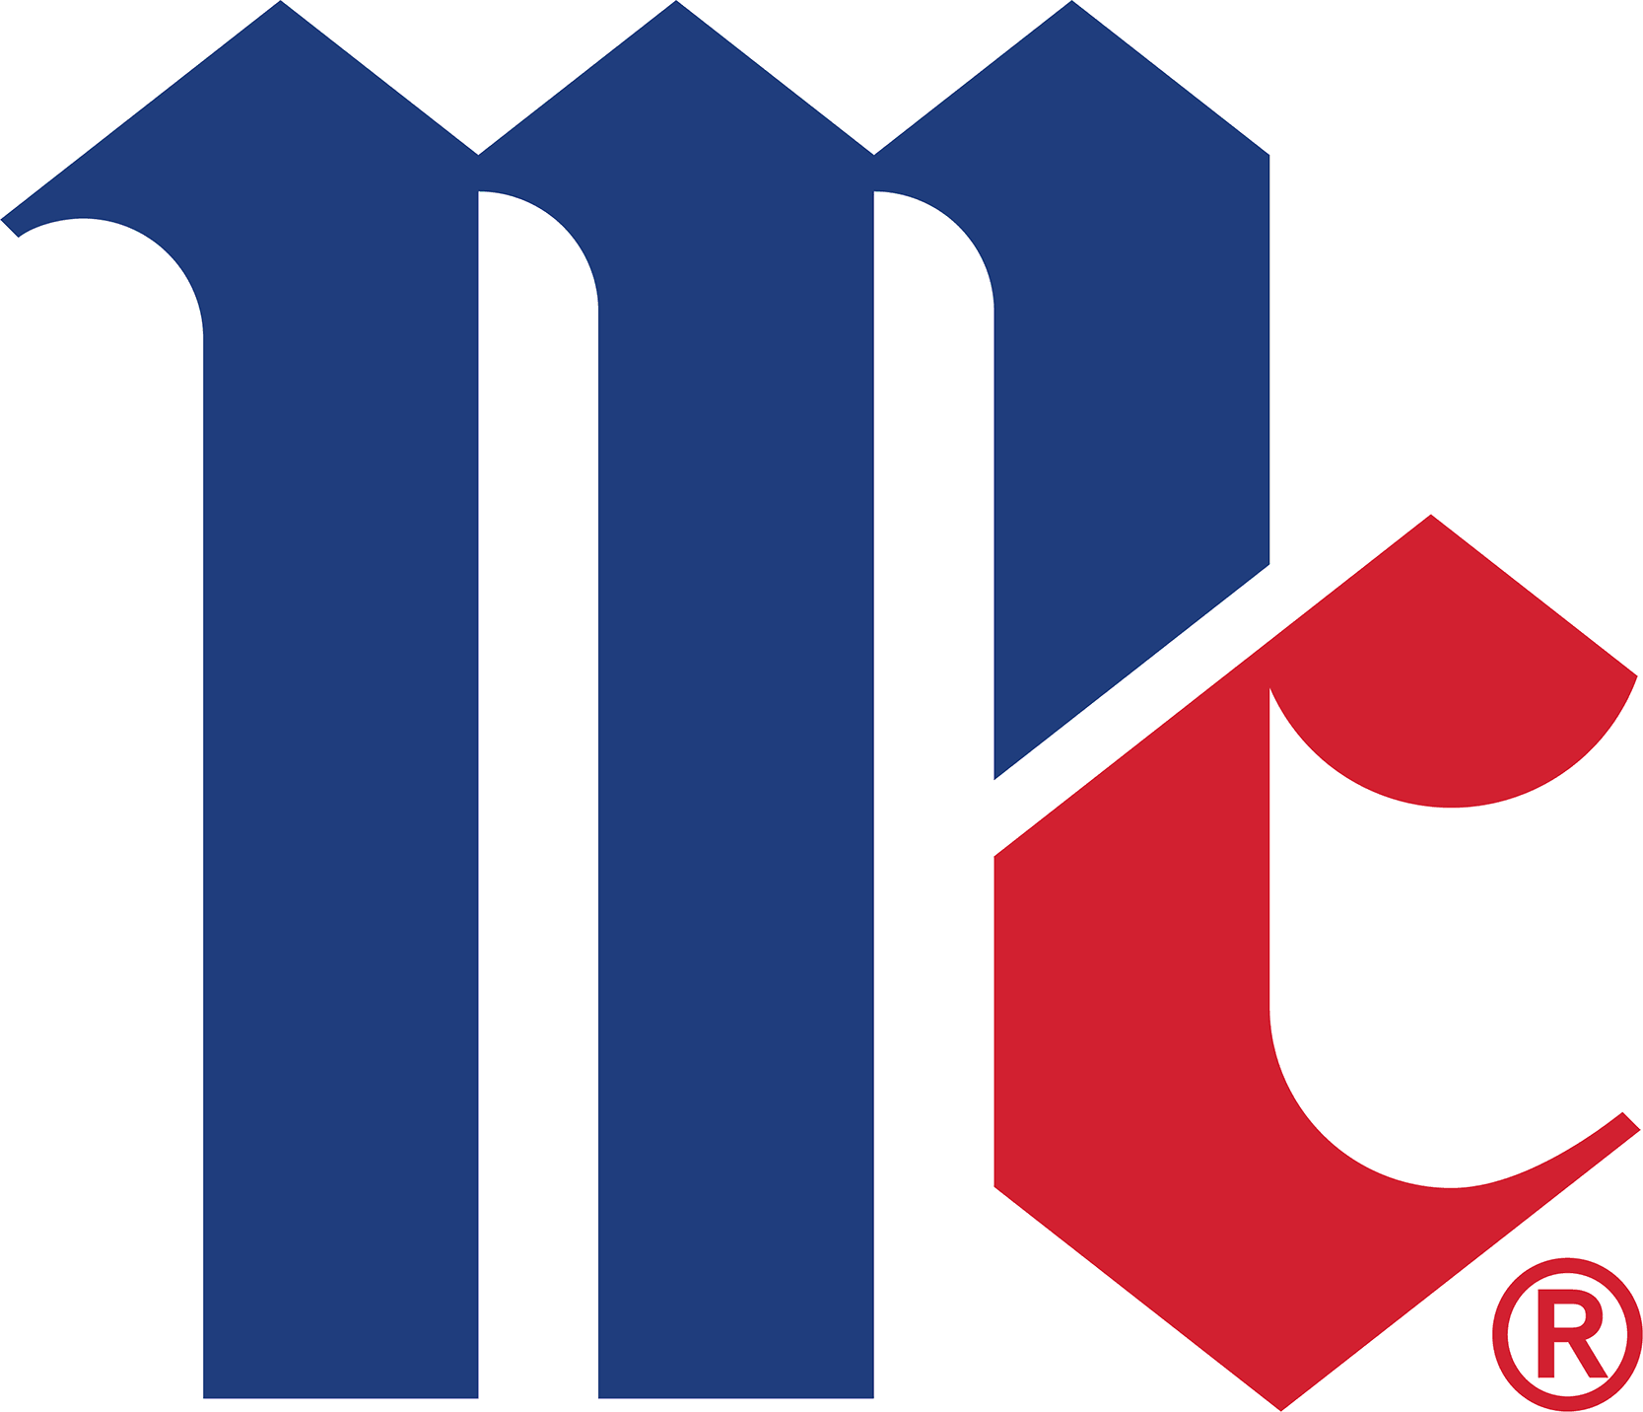
IBM Blockchain
Making blockchain real for businesses
Trade Finance | Pre and Post Trade | Complex Risk Coverage
Identity/ Know your customer (KYC) | Unlisted Securities/ Private Equity Funds | Loyalty Program
Medicated Health Data Exchange | Fraud/ Compliance Registry | Distributed Energy/ Carbon Credit
Supply Chain | Food Trust | Provenance/ Traceability
Notes:
With IBM Blockchain, IBM is making Blockchain a reality for many businesses and industries. Here are just a few.

Slide 26
Hyperledger Fabric and Composer
The Open Source core to IBM Blockchain
Notes:
So, what is Hyperledger Fabric and Hyperledger Composer that IBM Blockchain is built on?

Slide 27
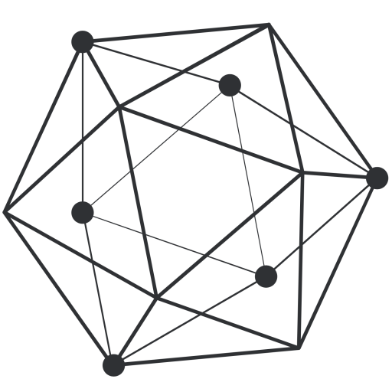
Hyperledger
A linux foundation project
A collaborative effort created to advance cross-industry blockchain technologies for business
Founded February 2016; now more than 185 member organizations
Open source, open standards, open governance
Five frameworks and four tools projects
IBM is a premier member of Hyperledger
Notes:
Hyperledger is an open-source, Linux Foundation project. IBM is a premier member of Hyperledger along with more than 185 member organizations.
Fabric is one of five frameworks and four tools projects covered by Hyperledger.
Fabric is focused on Blockchain for Business

Slide 28
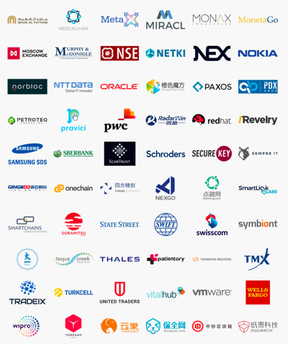
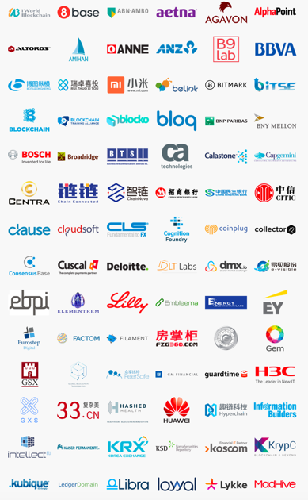
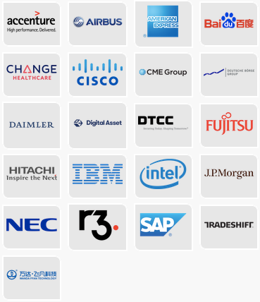
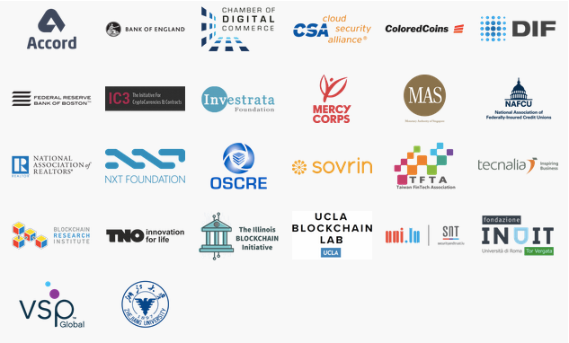
Hyperledger Members
Ibm is a premier member
General
General
Premier
Source: https://www.hyperledger.org/members
Updated: 26 January 2018
Associate

Slide 29
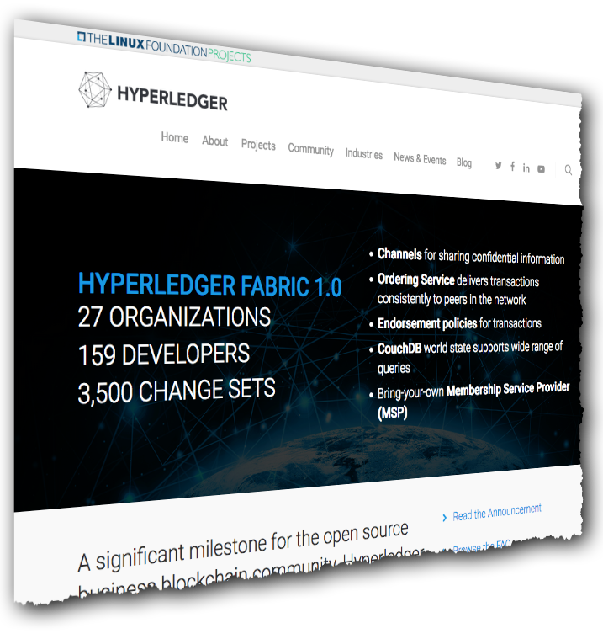
Hyperledger Fabric
The blockchain for business platform
An implementation of blockchain technology that is a foundation for developing blockchain applications
Emphasis on ledger, smart contracts, consensus, confidentiality, resiliency and scalability.
V1.0 released July 2017
159 developers from 27 organizations
IBM is one contributor of code, IP and development effort to Hyperledger Fabric
Notes:
Hyperledger Fabric is the Blockchain for Business Platform. It has an emphasis on the shared ledger, smart contracts, confidentiality and scalability.
IBM is one of the main contributers of code, IP and actually developed and donated Hyperledger Composer to the community.

Slide 30
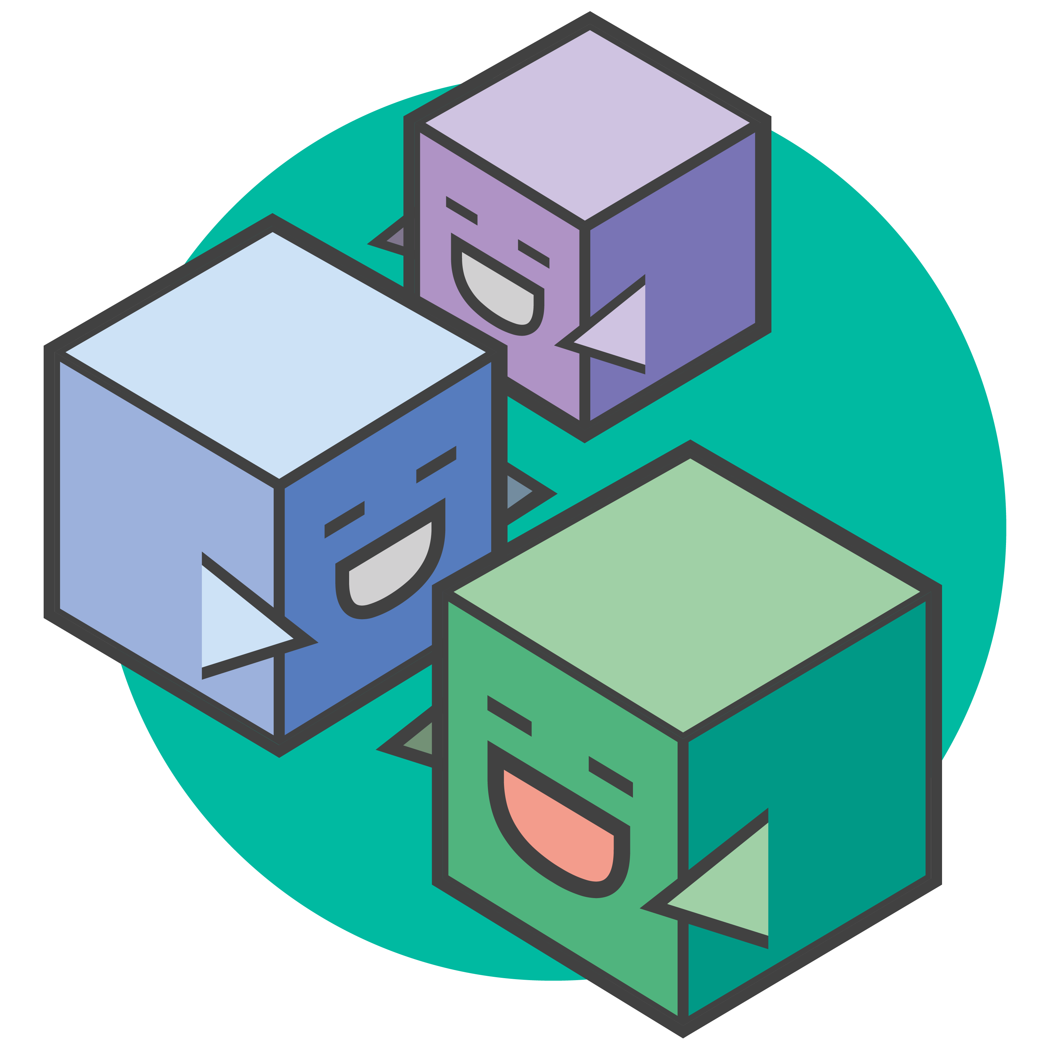
Hyperledger Composer
Accelerating time to value
A suite of high level application abstractions for business networks
Emphasis on business-centric vocabulary for quick solution creation
Reduce risk, and increase understanding and flexibility
Features
Model your business networks, test and expose via APIs
Applications invoke transactions to interact with business network
Integrate existing systems of record
Fully open and part of Linux Foundation Hyperledger
Notes:
Hyperledger composer is the development environment for building Hyperledger Fabric-based business networks.
It simplifies the development by focusing on business-centric vocabulary and uses common programming skills and technologies like JSON and JavaScript.

Slide 31
Hands-on Lab
Building your first Blockchain Business Network
Notes:
Now, let’s see it in action. We’re going to work with a Business Network in Hyperledger Composer.

Slide 32
Lab Agenda
Building your first blockchain business network
1
Hyperledger Composer Concepts
2
Access the Composer Playground
3
Modeling Language Basics
4
Build the Network
5
Test the Network
6
Export the Network
Notes:
But first, we need to understand some common Hyperledger Composer Concepts
We will use a free, cloud instance of Hyperledger Composer called the Composer Playground
We will give you the basics of the Composer Modeling Language
You will build a network from a template
You will test that network
Finally, we’ll export the network so you can save your work

Slide 33
Conclusion
Notes:
Thank you for your time today, hopefully, you now better understand Blockchain and have a good understanding of how to develop a network with Hyperledger Composer

Slide 34
Notes:
Please complete the survey at the link below.
Thank you and have a great day

